Slide 1

END-TO-END ANALYTICS • MACHINE LEARNING • EXPLAINABILITY
Telco Customer Churn
Prediction Using Machine Learning
Predicting customer attrition and identifying churn drivers using advanced machine learning models

Slide 2
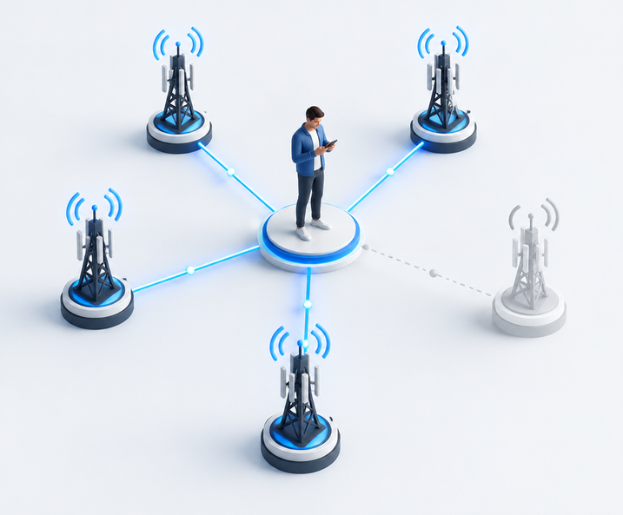
Churn erodes value at every turn
Customer attrition reduces recurring revenue while forcing operators to spend more to replace lost relationships. The goal: identify likely churners early—and explain why.
Revenue
Acquisition
Recurring income walks out the door
Replacement costs rise
CLV
Uncertainty
Lifetime value contracts
Planning becomes less reliable

Slide 3
7,043 customers. One binary outcome.
A compact view of who customers are, what they buy, and how they pay.
TARGET
7,043
0 RETAINED
1 CHURNED
CUSTOMER RECORDS
Demographics
Gender • Senior Citizen • Partner
Account
Tenure • Contract • Payment
Services
Internet • Security • Support
Billing
Monthly Charges • Total Charges

Slide 4
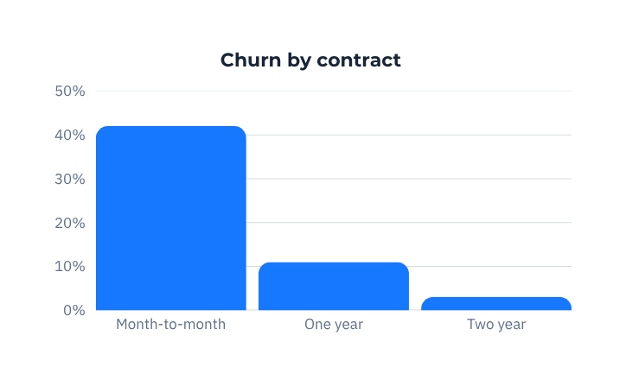
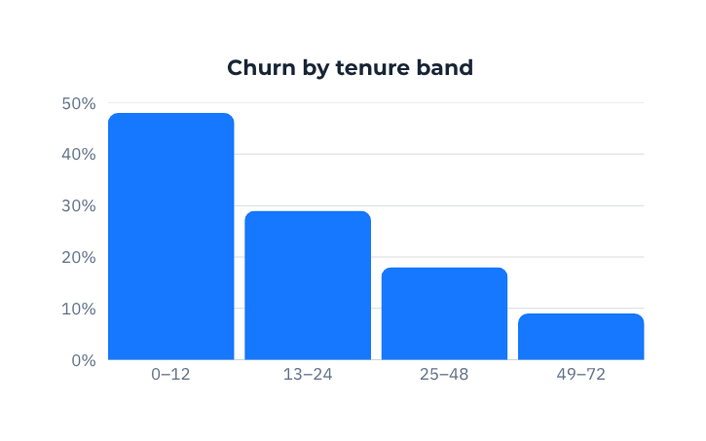
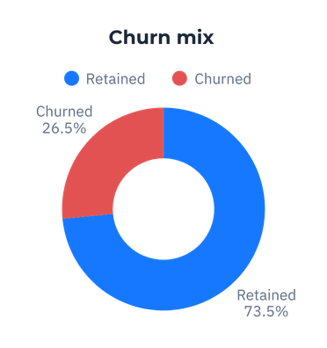
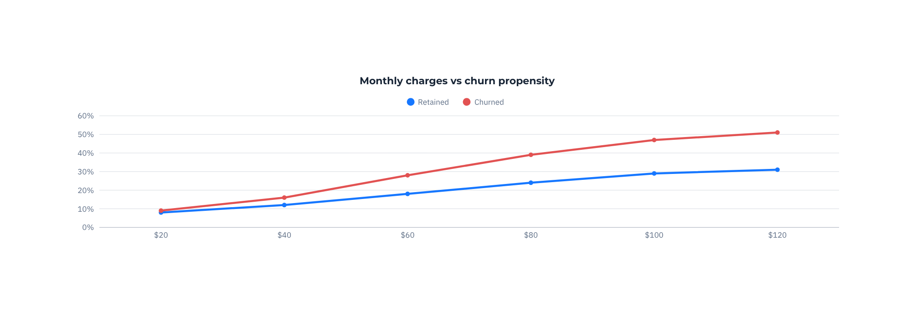
EDA reveals a contract problem
Month-to-month contracts show the highest churn risk.

Slide 5
From raw records to model-ready signals
A governed sequence removes noise, standardizes meaning, and retains the features that matter.
Data
cleaning
Missing value
handling
Type
conversion
Categorical
encoding
Feature
selection
Encoding example
YES → 1 NO → 0

Slide 6
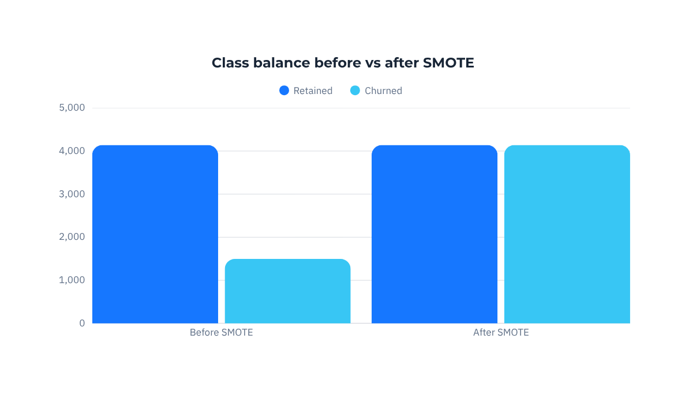
Scale the signal. Balance the learning.
StandardScaler
Centers numerical features around zero and aligns variance—so magnitude does not dominate learning.
TENURE
MONTHLY CHARGES
TOTAL CHARGES
SMOTE
Synthetic minority samples rebalance the training set and improve minority-class learning.

Slide 7
One pipeline. Ten disciplined decisions.
From source data to trusted action
Data
Collection
Data
Cleaning
Encoding
Train–Test
Split
Feature
Scaling
SMOTE
Model
Training
Model
Evaluation
SHAP
Business
Action

Slide 8
Three models. Different strengths.
Logistic
Regression
Random
Forest
XGBoost
Interpretable baseline
Robust ensemble
BEST PERFORMER
Fast, transparent probability estimates. Best for directional understanding and benchmarking.
Captures non-linear patterns and interactions with limited tuning. Strong general-purpose challenger.
Gradient boosting delivers superior discrimination, generalization, and resilience on imbalanced data.

Slide 9
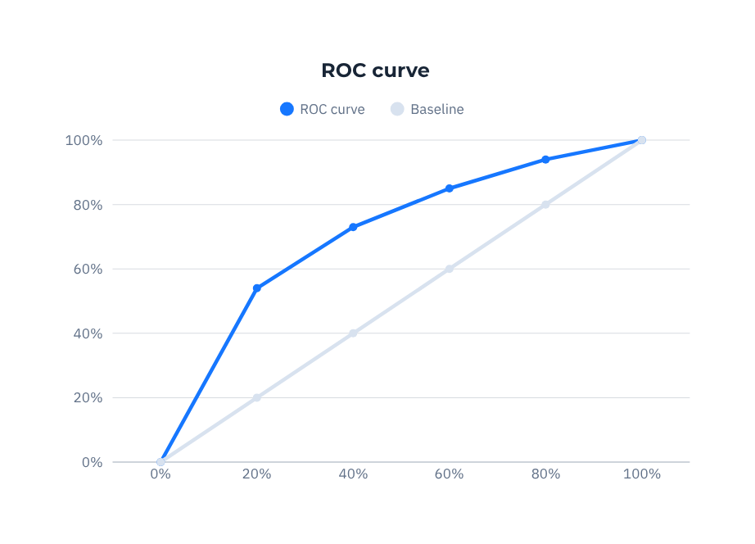
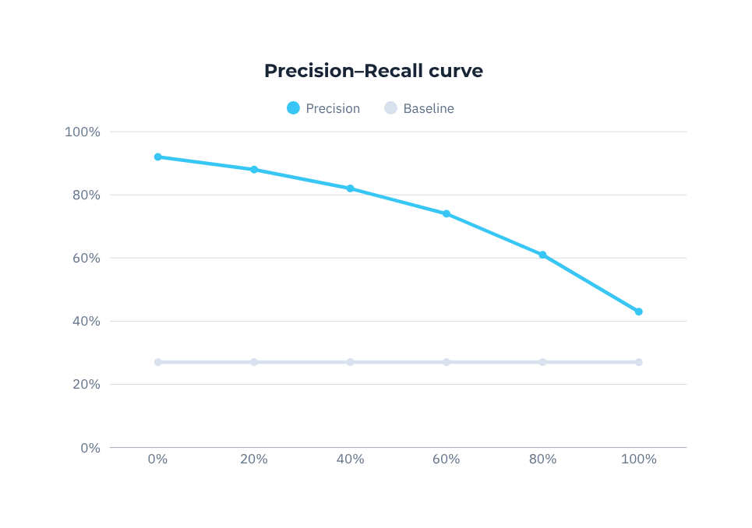
Evaluate for the cost of a miss
Recall matters most
A false negative is a customer we fail to save.
Accuracy
Precision
Recall
F1 Score
ROC–AUC

Slide 10
XGBoost wins on the decisions that matter
High discrimination • non-linear learning • strong generalization • imbalance resilience
TREE 1
TREE 2
TREE 3
FINAL PERFORMANCE
XGBoost
Accuracy — 77.52%
Recall — 58.00%
F1 Score — 58.00%
ROC–AUC — 64.61%
TREE 4
TREE 5
TREE 6

Slide 11
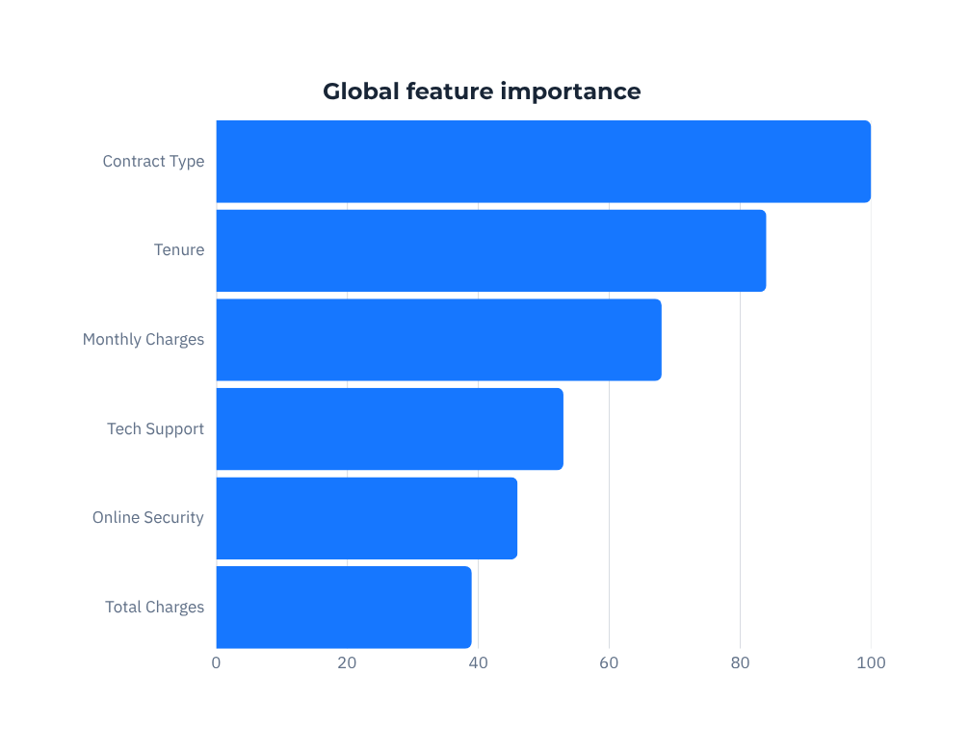
Explain every prediction
Transparency builds business trust
SHAP assigns each feature a contribution—turning a powerful model into an auditable business tool.
Contract Type
Tenure
Monthly Charges
Tech Support
Online Security
Total Charges

Slide 12
Five signals define the retention agenda
Month-to-month
contracts
Low tenure
customers
Higher monthly
charges
Highest likelihood to churn
Early relationship is fragile
Value perception is under pressure
No Online
Security
No Tech
Support
Protection gap raises risk
Service confidence declines

Slide 13
Turn prediction into a retention system
Prioritize interventions by customer moment, value, and predicted risk.
1 Encourage long-term contracts
2 Incentivize new customers
Convert flexibility into commitment
Protect the first 90 days
3 Bundle services to increase value
4 Promote security & support add-ons
Make the relationship stickier
Close the confidence gap
5 Launch targeted retention campaigns
6 Integrate scores into CRM workflows
Match offer to risk and value
Trigger the next-best action automatically

Slide 14

From churn prediction
to customer value
CLEAN → ENGINEER → BALANCE → TRAIN → EXPLAIN → ACT
“Data-driven retention strategies can significantly reduce customer churn and improve customer lifetime value.”

